Slide 1
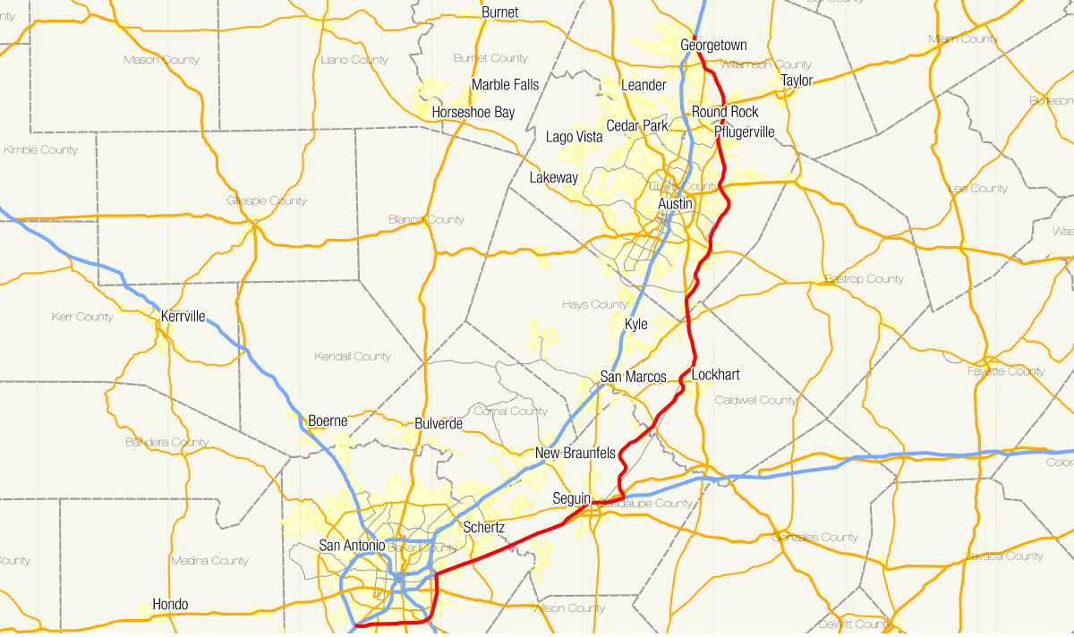
Coursera Capstone Project - The Battle of Neighborhoods Housing recommendation based on the crime rate in Austin area
Kripa Ranjit

Slide 2

Agenda:
Objective and Problem Statement
Resolution
Automation
Input/ Output
Benefits
Limitations

Slide 3
Objective and problem statement
Objective:
-Investigate the crime rates based on the zip code in the location of Austin
-Recommend various locations where the prospective client can move into the area based upon his/ her budget using Machine Learning.
Problem Statement:
People usually want to live in a peaceful environment. Due to the crime rates in the area people tend to have negative living experience. People find it very hard to find a suitable place and neighborhood to accommodate them and their families. Due to crime rates and other multiple issues, housing has been struggling. It would be so much easier if people could look over the areas with less crimes when moving to a certain area.
With the annual crime rate dataset, people can derive useful information about the crime rates in different areas of Austin. This would help the people to make decision on where to move.

Slide 4
Resolution
With provided authentic data from austintexas.gov on Austin locations, we can get the number of crimes that occurred in the year 2015. This would help the potential client to make an informed decision about moving into a suitable location.
The automated solution using Machine Learning techniques parses the necessary data from the crime rate dataset. After cleansing, data is further condensed by selecting the zip code, the latitude and longitude, name of the crime and street name. The number of crimes on each of these zip codes is determined by using the count function and arranged in ascending order.
Further, location coordinates (latitude, longitude) of these street names are fetched by making API calls to
Google Maps.
The recommended locations are further fed into Foursquare API calls to determine various venues in proximity to them. All reported venues are then tabulated and presented to the user.

Slide 5
Automation Script:
Scripting language | Python (Python 3x)
IDE | https://labs.cognitiveclass.ai/tools/jupyterlab/
Input | Open Data published by Government of UK under the section HM Land Registry: Price Paid Data Google Maps Geocoding API Foursquare location data
Output | List of recommended locations Recommended locations in Austin plotted on map.

Slide 6
Benefits
Dynamic recommendations
Flexibility in choosing the location
Recommendations plotted on map for clarity

Slide 7
Scope of Improvement:
Utilization of data which dates to 2015.
Enable additional condition checking for different PROPERTY types.
Interactive UI

Slide 8
Questions?

Slide 9

THANK YOU

